Slide 1





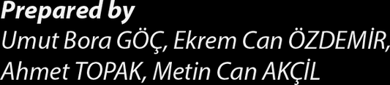

Notes:
Hello everyone. It's so exciting to be in Portugal with our Project partners.We are very happy to meet again some of our friends who took part in previous meetings.Let me introduce myself briefly,
my name is ahmet
I'm 17 years old. I'm studying in the ITC department. I'm working on Arduino and Software devolopment and
we have a startup software company with ekrem and bora

Slide 2
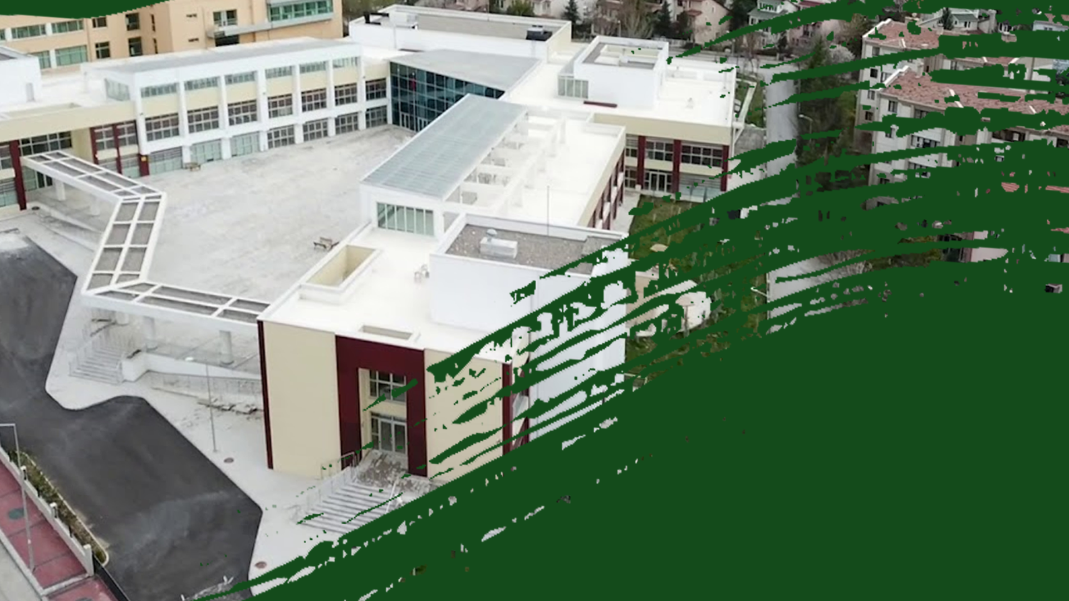

Paragraf metniniz
Notes:
SERÇEV Vocational and Technical High school was built in 2017(two thousand seventeen)
Our school is
THE FIRST and
ONLY high school in Turkey
to provide education
for Cerebral Palsy students,
Special Need Students
as well as regular students. (Ahmet)

Slide 3





Notes:
Our school has 1 Principal
3 Vice Principals and
53 (Fifty three) teachers .
In our school
223 ( Two hundread twenty three) students are taking education.

Slide 4







Notes:
We have the three branches of vocational education.
They are

Slide 5
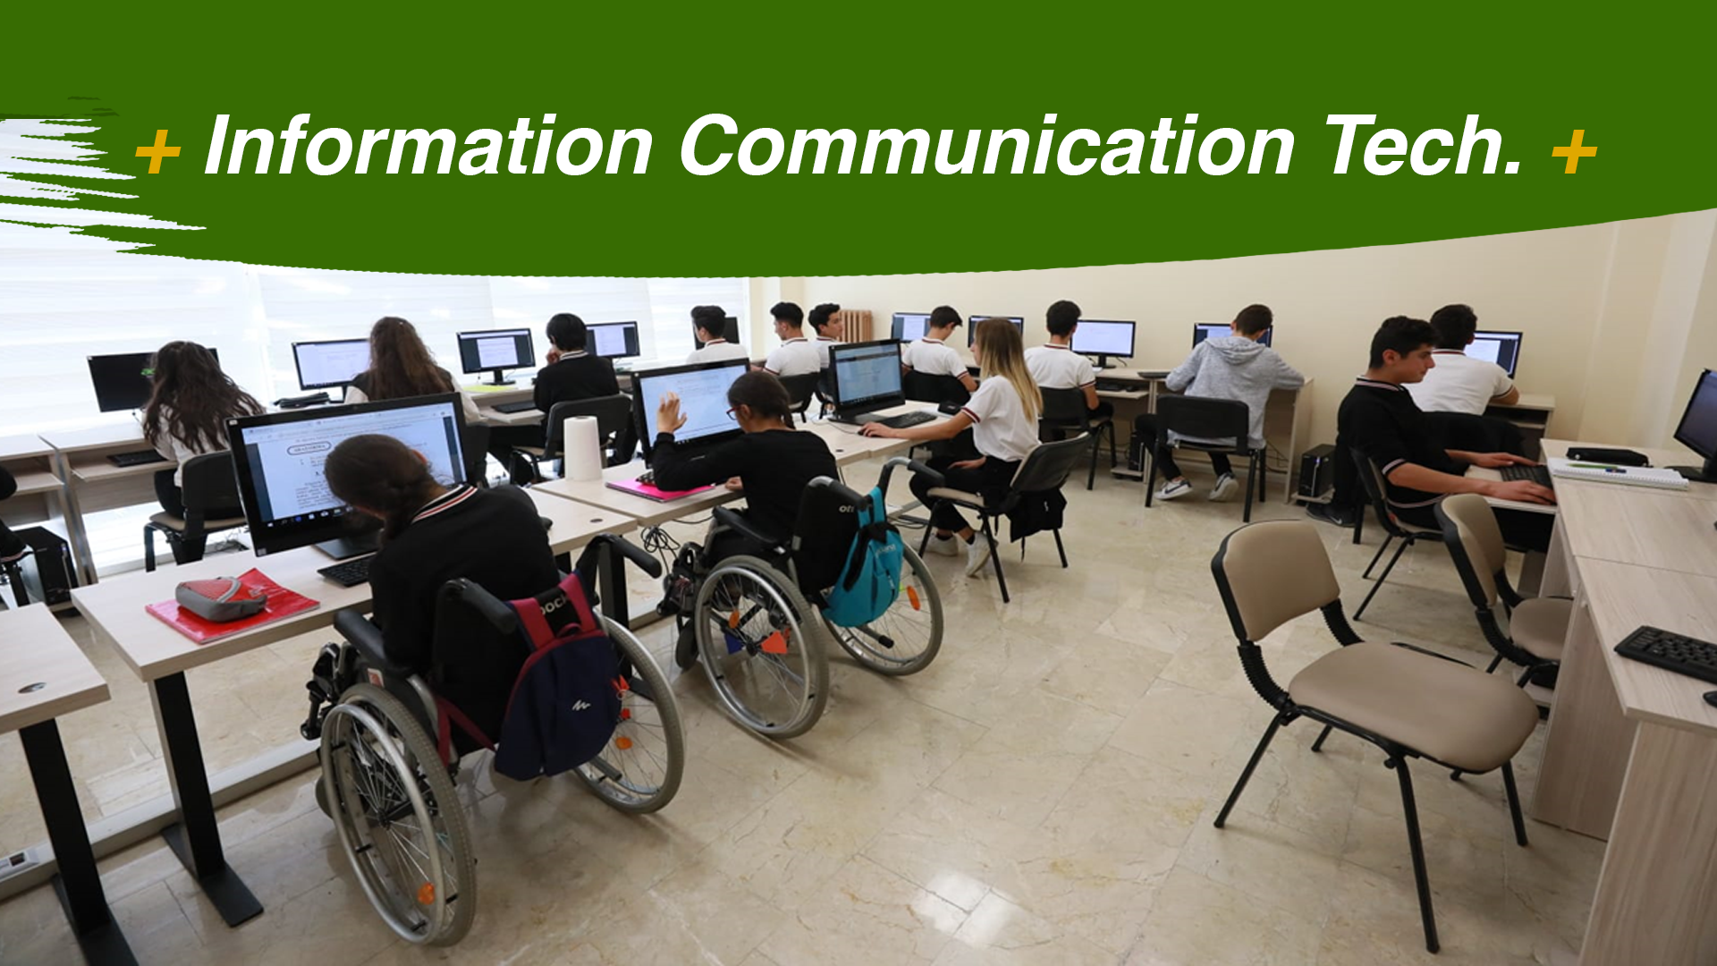
Notes:
Information Communication Technologies
ICT

Slide 6
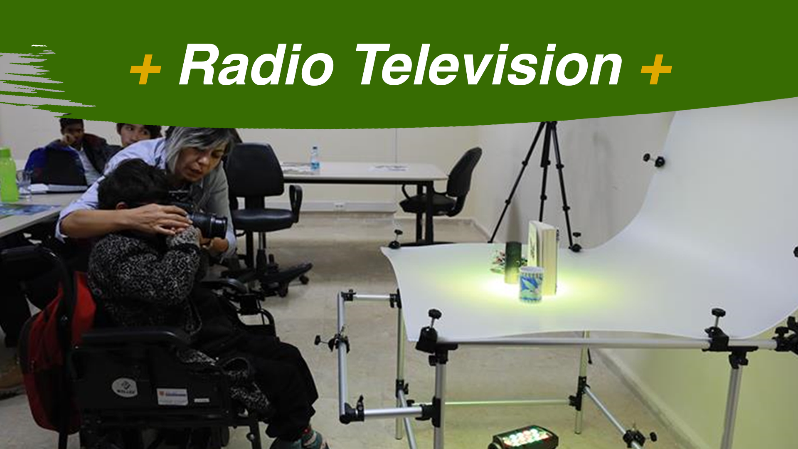
Notes:
Radio Television

Slide 7
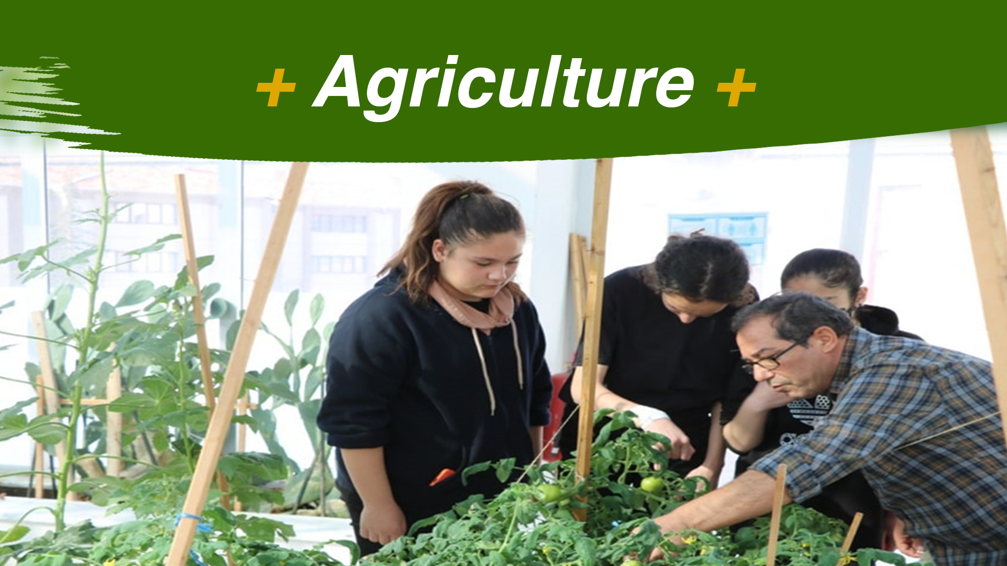
Notes:
And Agriculture.
Students
with non disabilities
and with disabilities
are attending
the courses together.

Slide 8

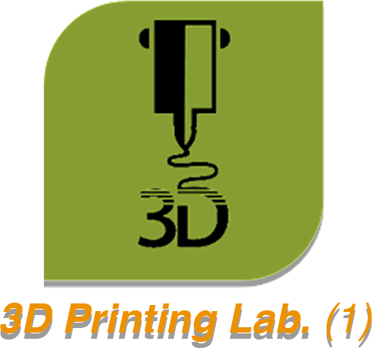
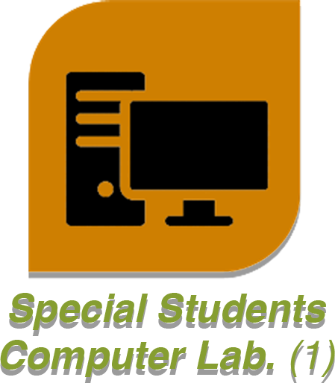

Notes:
Let`s
have a look at
the school building,
and the school atmosphere .
Our School has a 3D Printing Lab,
Special Students’ Computer Lab,
and
a Science lab.

Slide 9

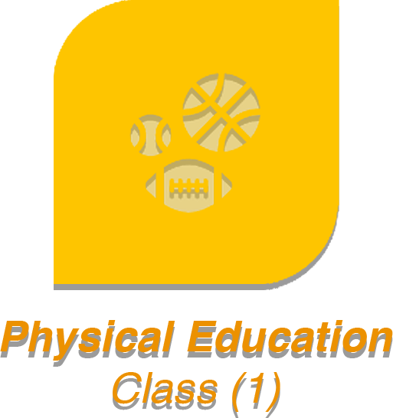
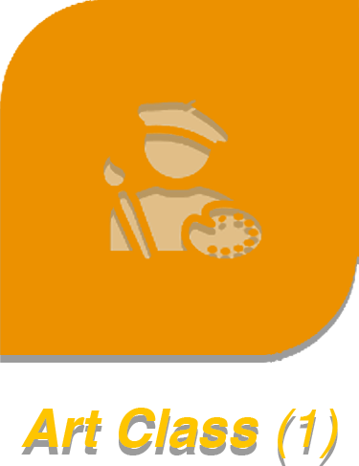

Notes:
And there is also
1 Physical Education Class,
1 Art Class and
1 Music Class

Slide 10


Notes:
We have two libraries
one library is equipped with computers and books
while the other library offeres connected and interactive enviroment
for students
to support
teaching and learning.

Slide 11
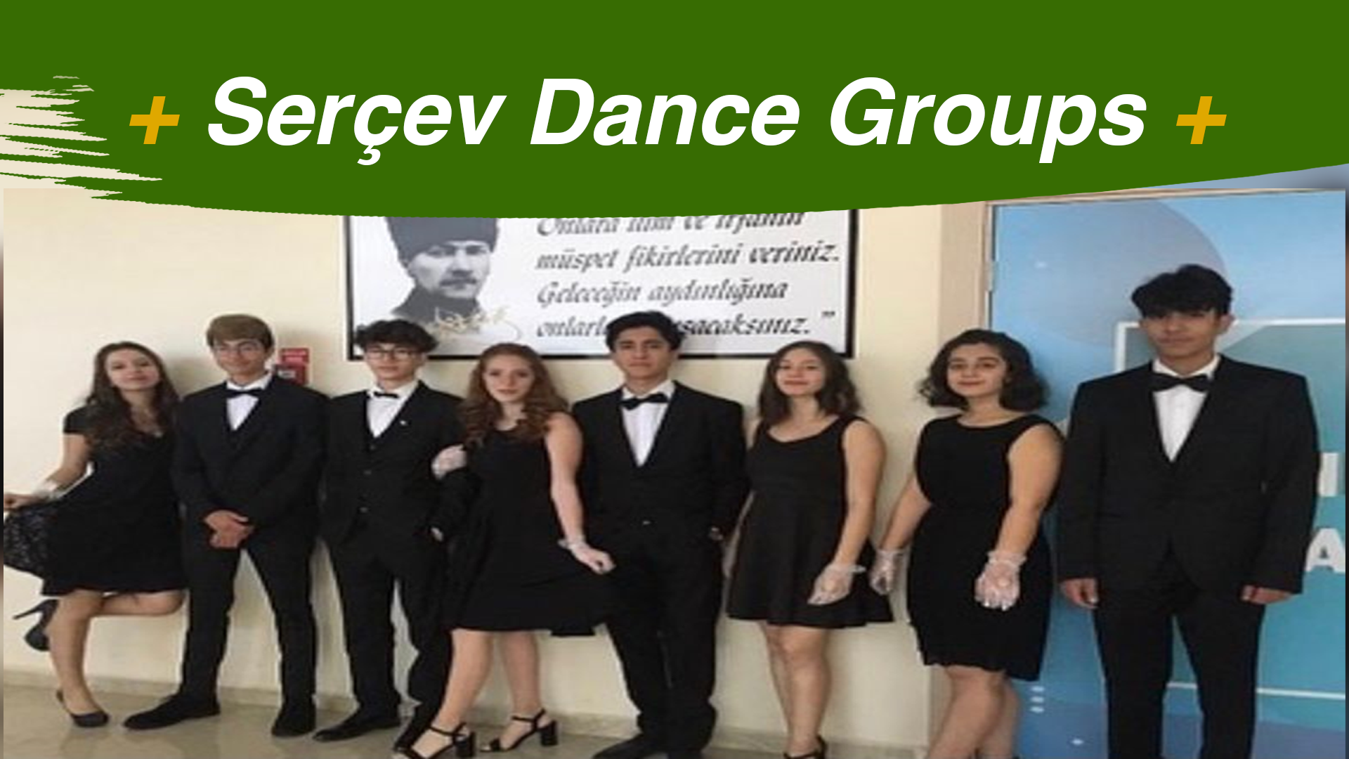
Notes:
In the conferance hall
which has a capacity of two hundered people
we gather for important days
like National Days.
For instance,
waltz dance
is performed
on the twenty ninth of October.
for the Republic Day of Turkey
by a group of students

Slide 12
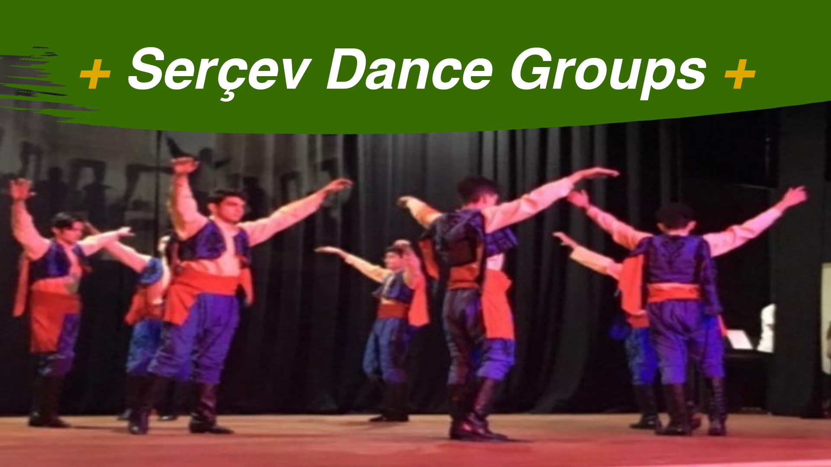
Notes:
We have
the chance to learn
not only the modern dances
but also
the traditional dances
like Seymen
and
Zeybek.
For example
Zeybek, which is a form of Turkish folk dance
Originated from Yörüks
particular to Western, Central and southern Anatolia in Turkey.

Slide 13
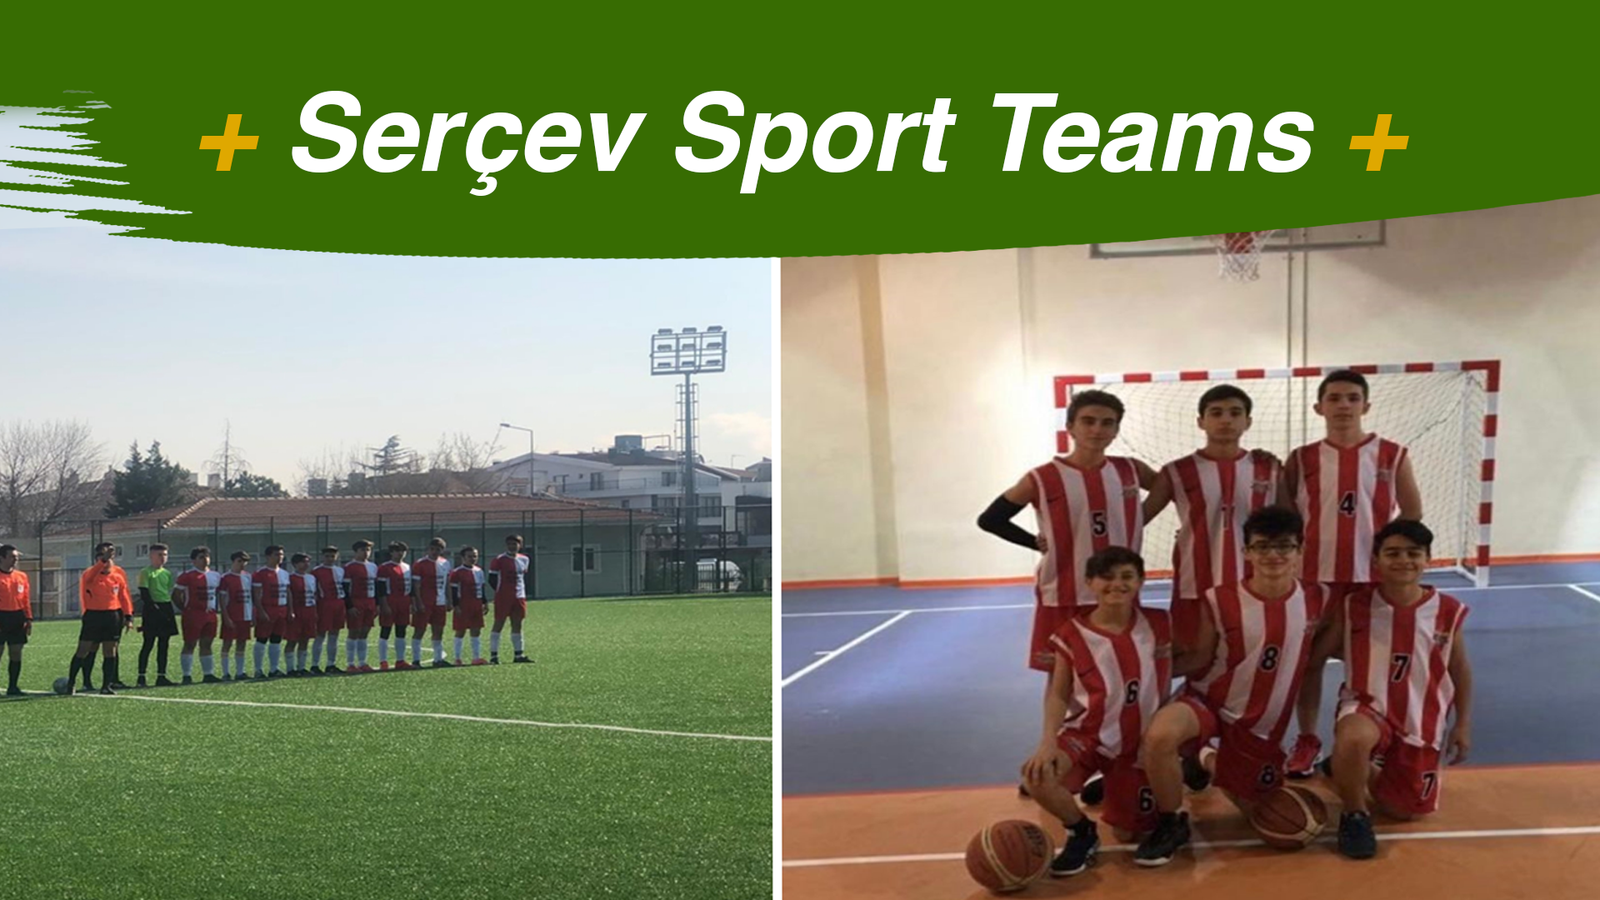
Notes:
Now we will tell you about the sports teams of our school
Our school has a football and basketball team.

Slide 14
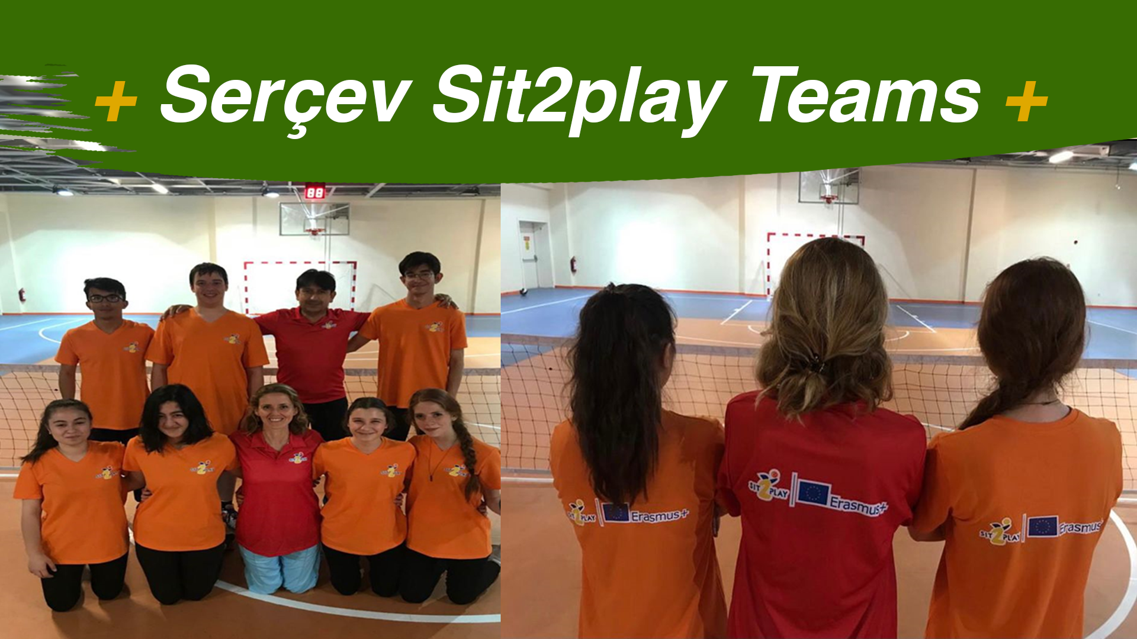
Notes:
Besides, these teams
we have a sitting volleyball team Sit2play is a Project funded by ERASMUS+ to promote sitting volleyball on a European scale
which developes inclusiveness ,fun and engament.

Slide 15
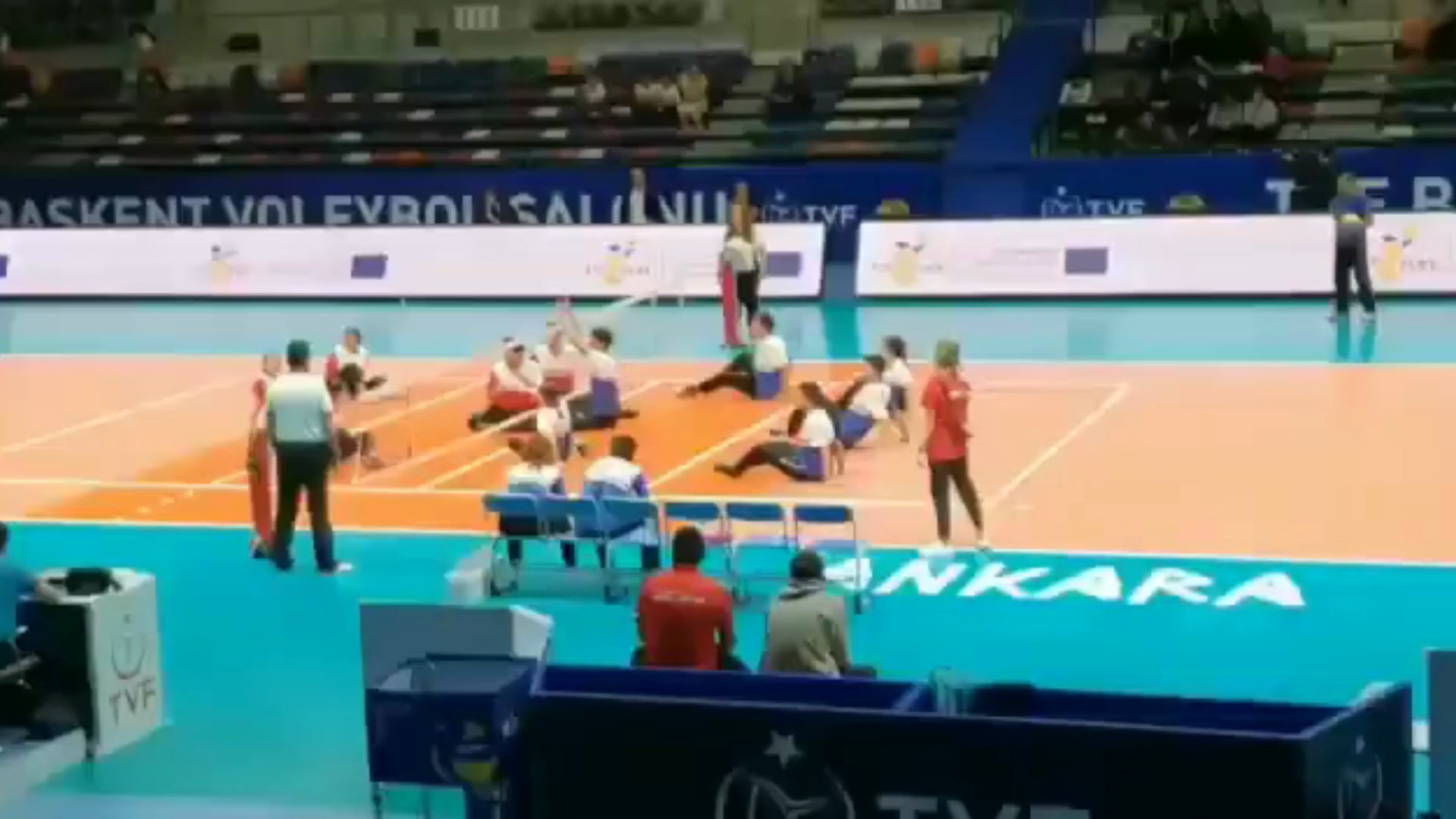
Notes:
Here is the video of Serçev sitting volleyball team match.

Slide 16
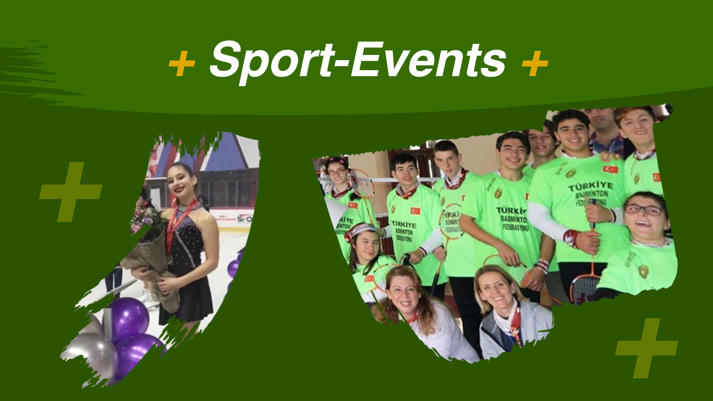
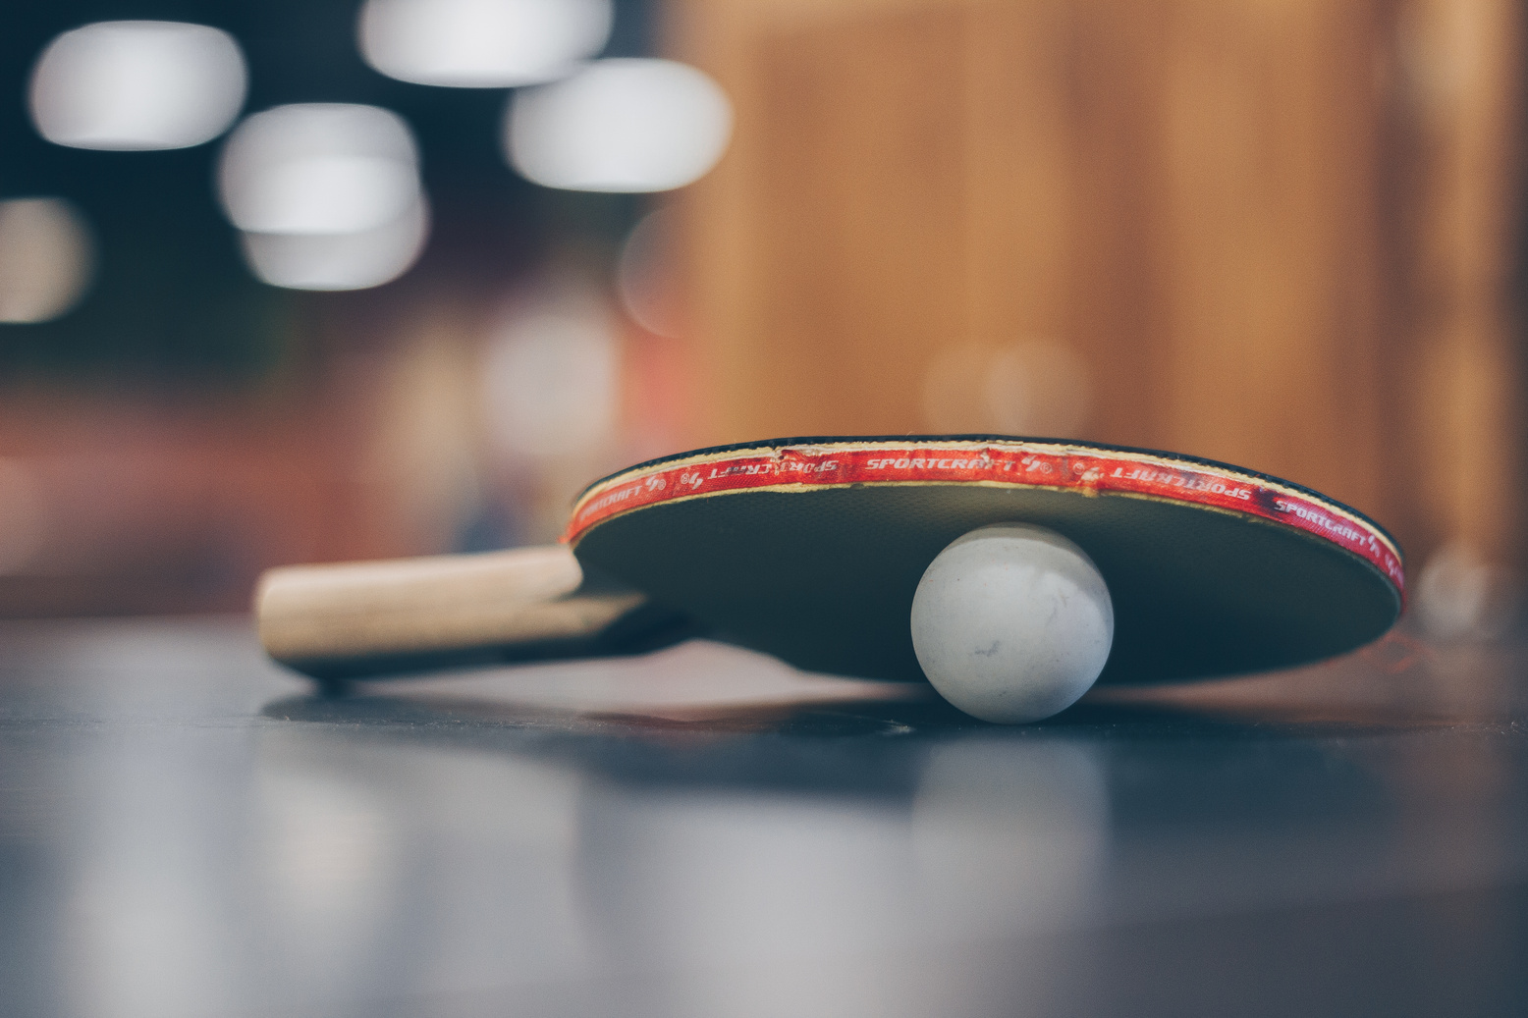
Notes:
In our school
students also show
interest to
badminton and table tennis.

Slide 17
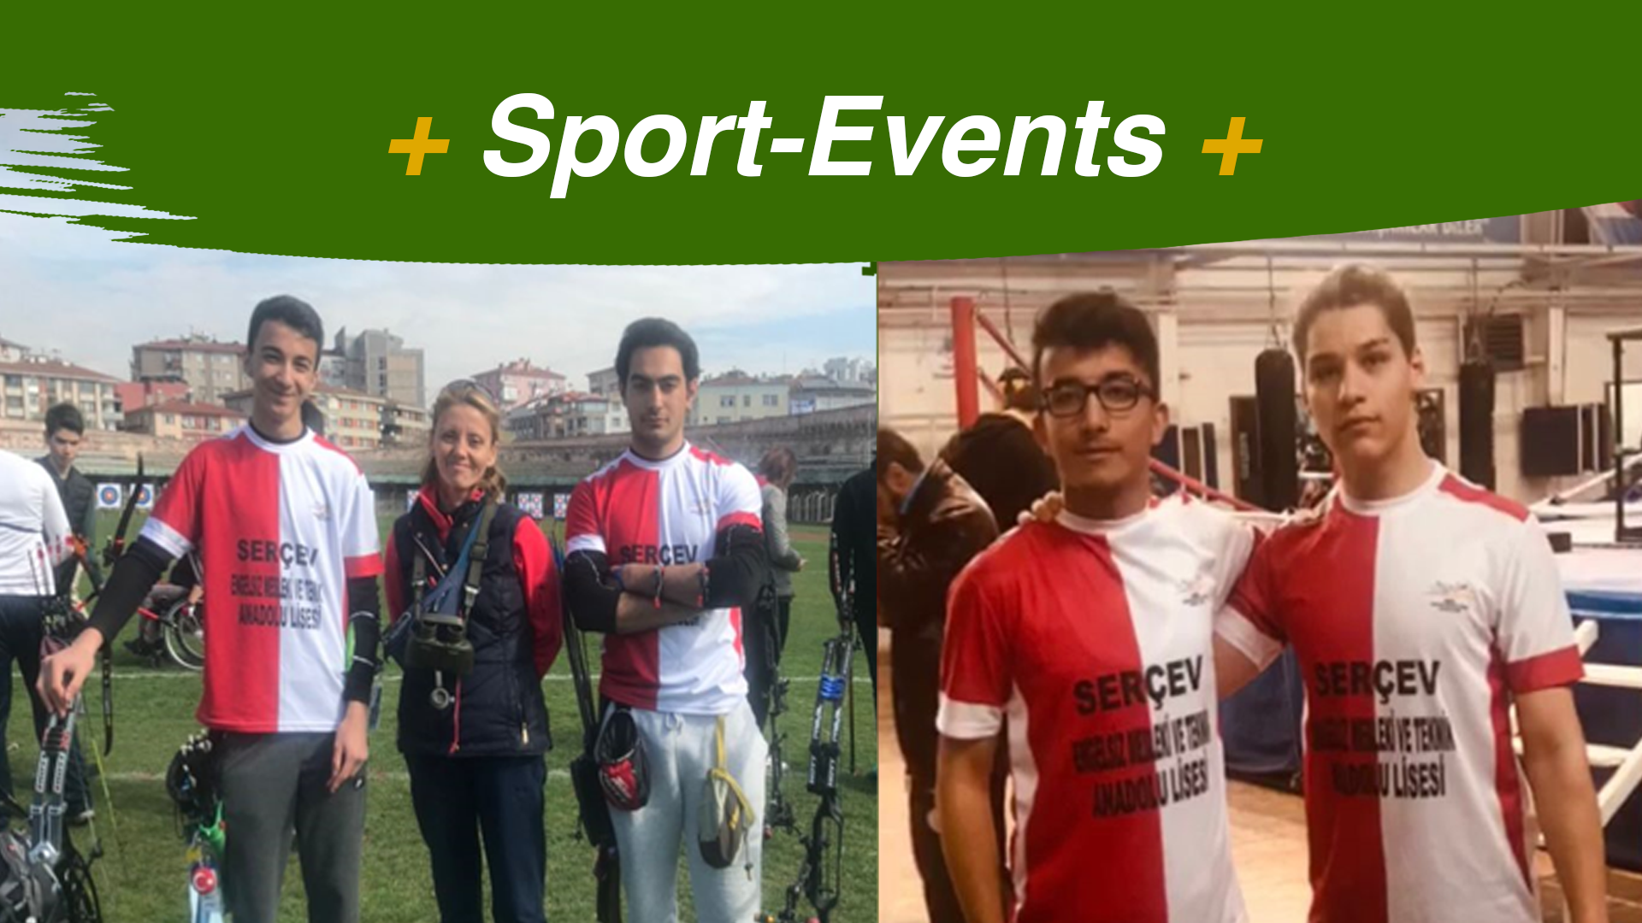
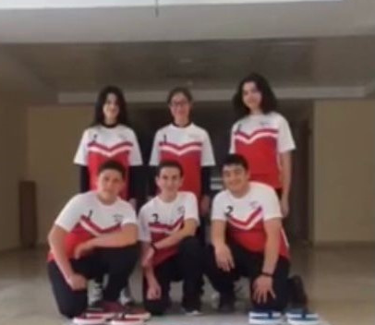
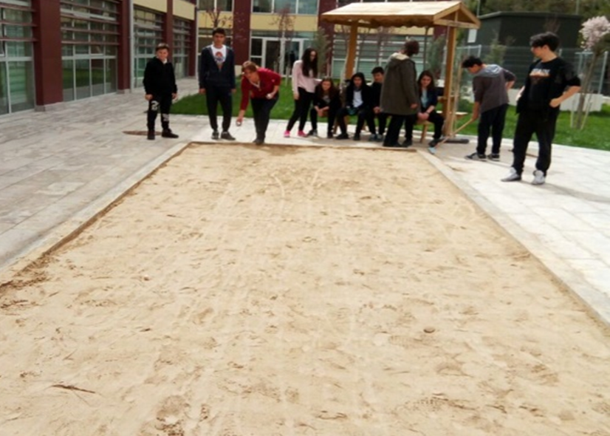
Notes:
Curling and Bocce
are the other sport activities
the students are doing.

Slide 18
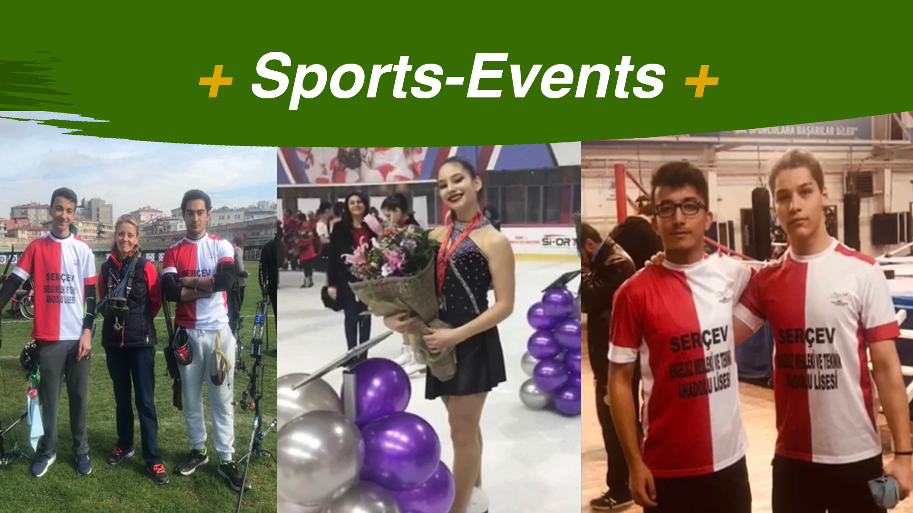
Notes:
Some of our friends
have degrees
in archery,
ice skating
and arm wrestling in Ankara and Turkey.

Slide 19
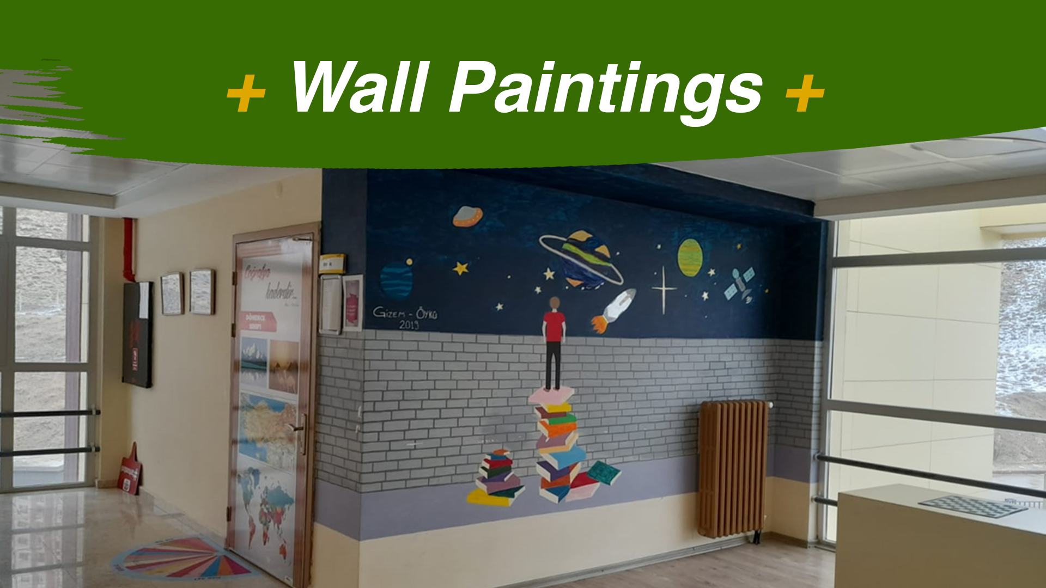
Notes:
For students
who have interest for painting
our school offers varios activites.

Slide 20
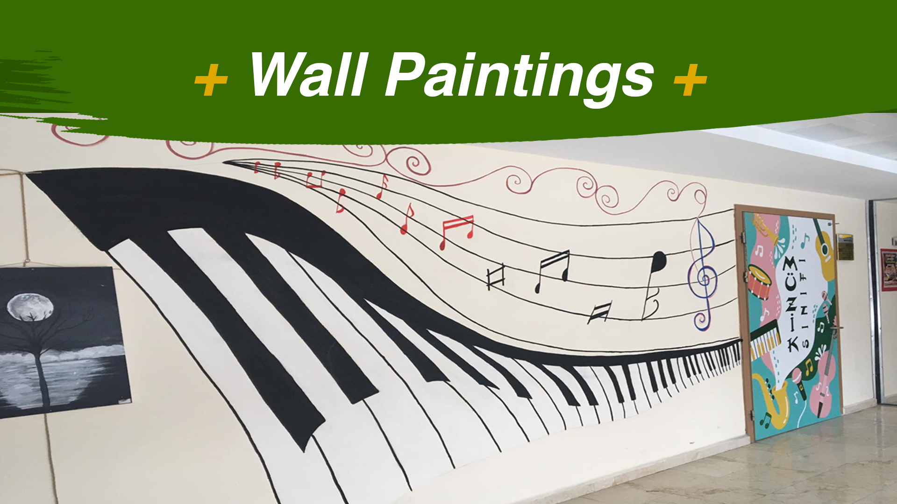
Paragraf metniniz
Notes:
For example
we really enjoy coloring the walls of our school.

Slide 21
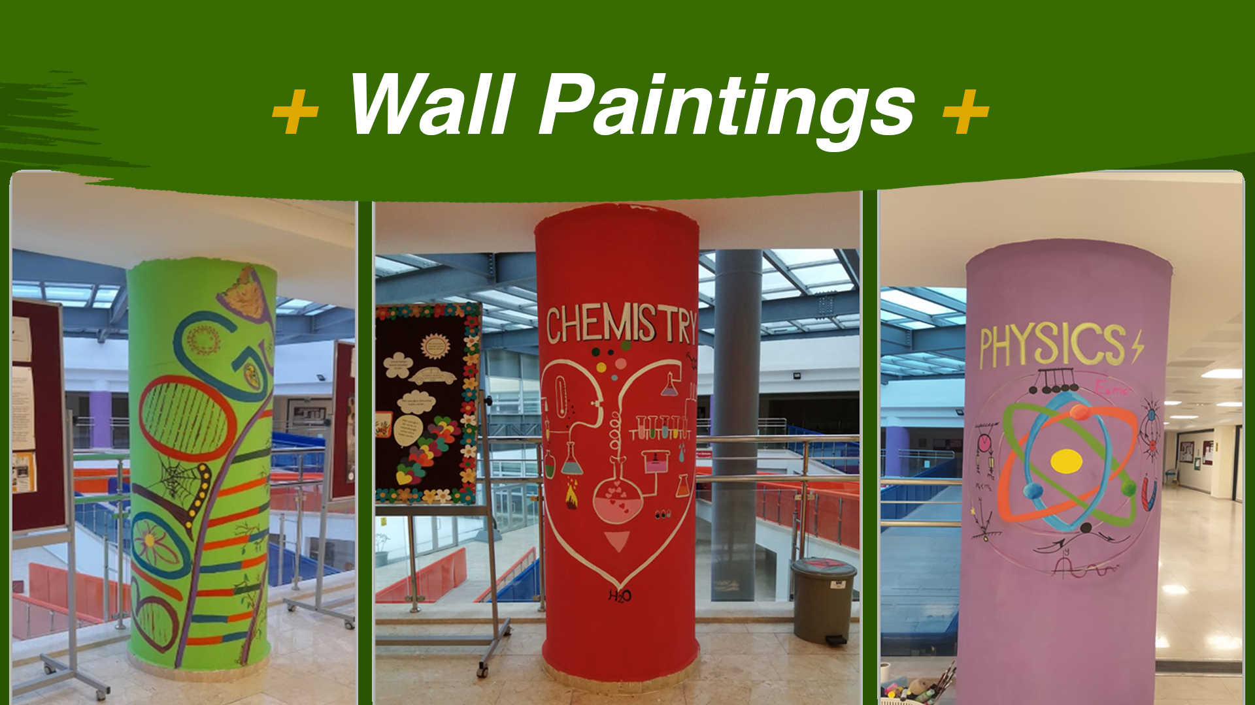
Notes:
These walls were cloured for the Project Science Connect.

Slide 22
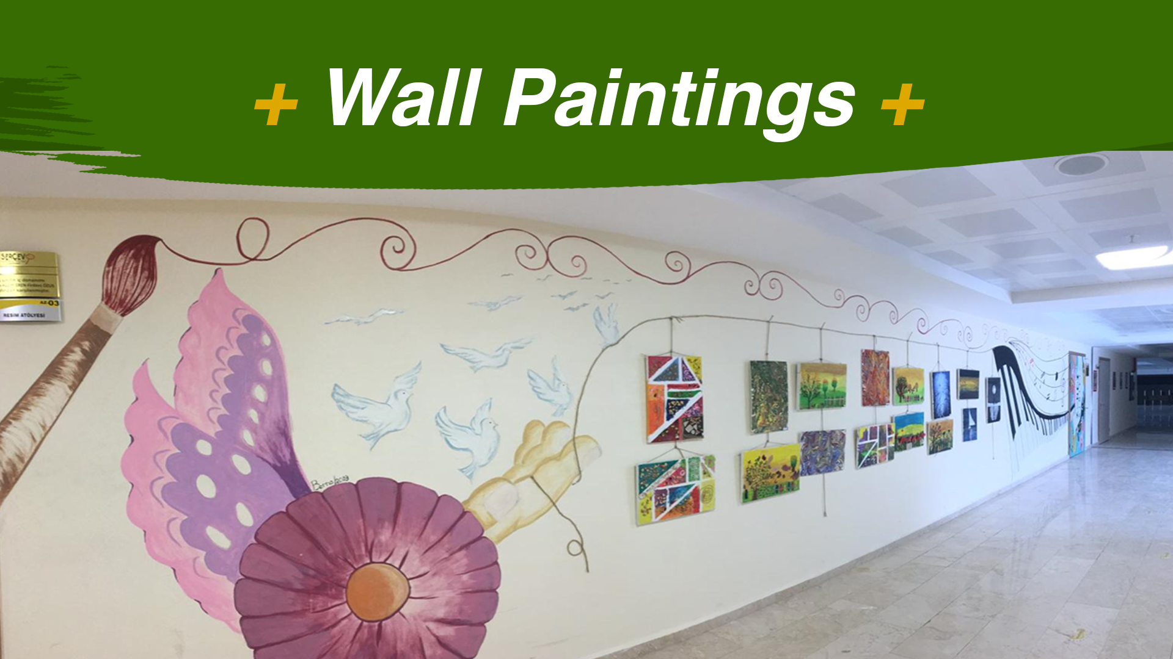
Notes:
And here are
the other examples.

Slide 23
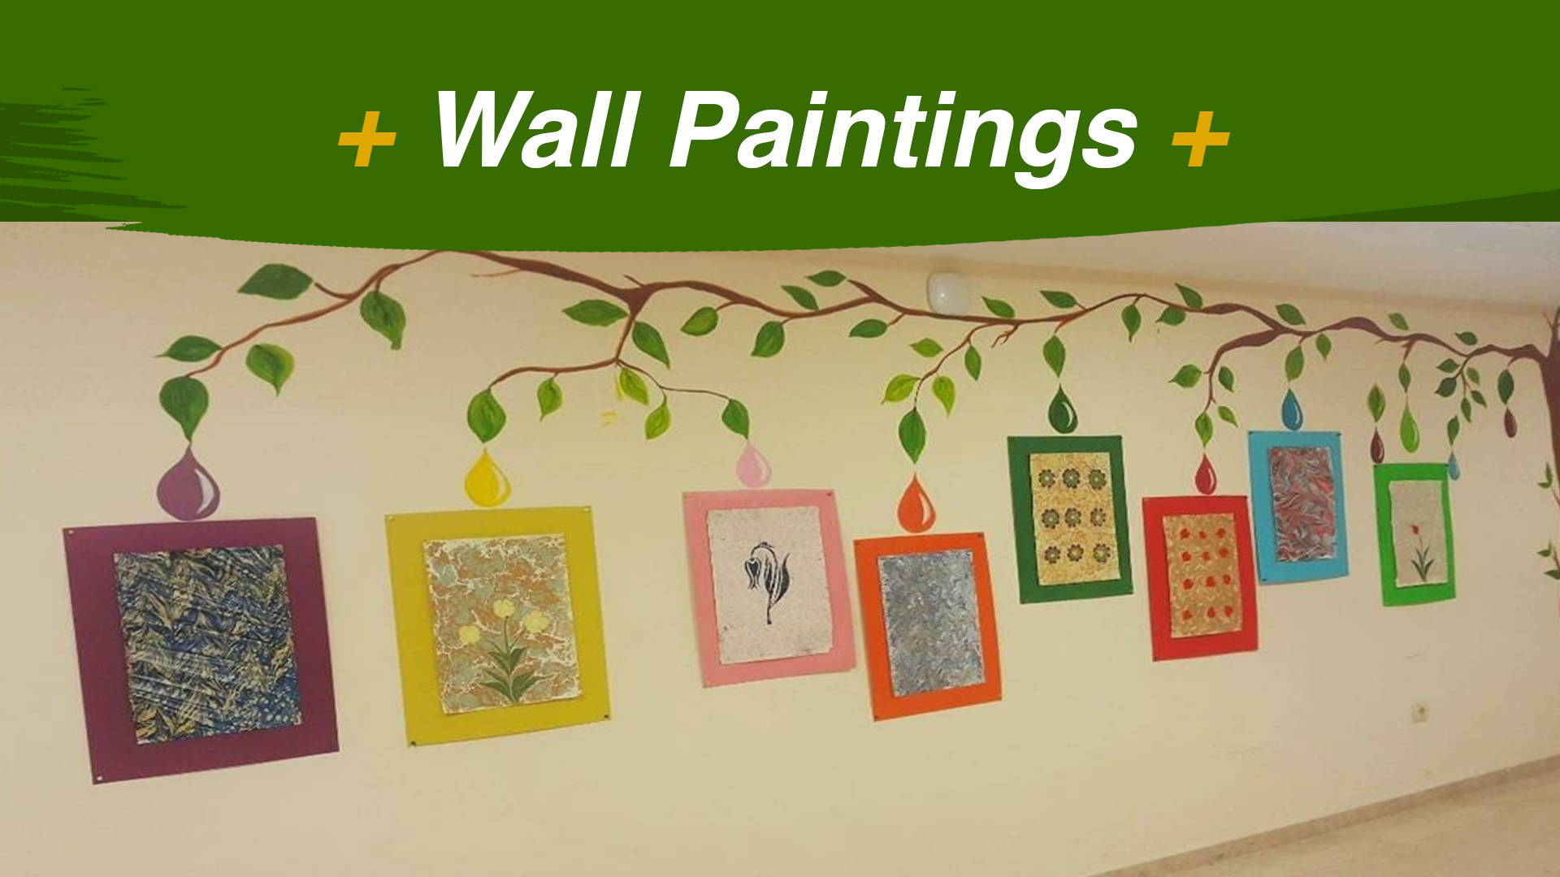
Notes:
And another one

Slide 24
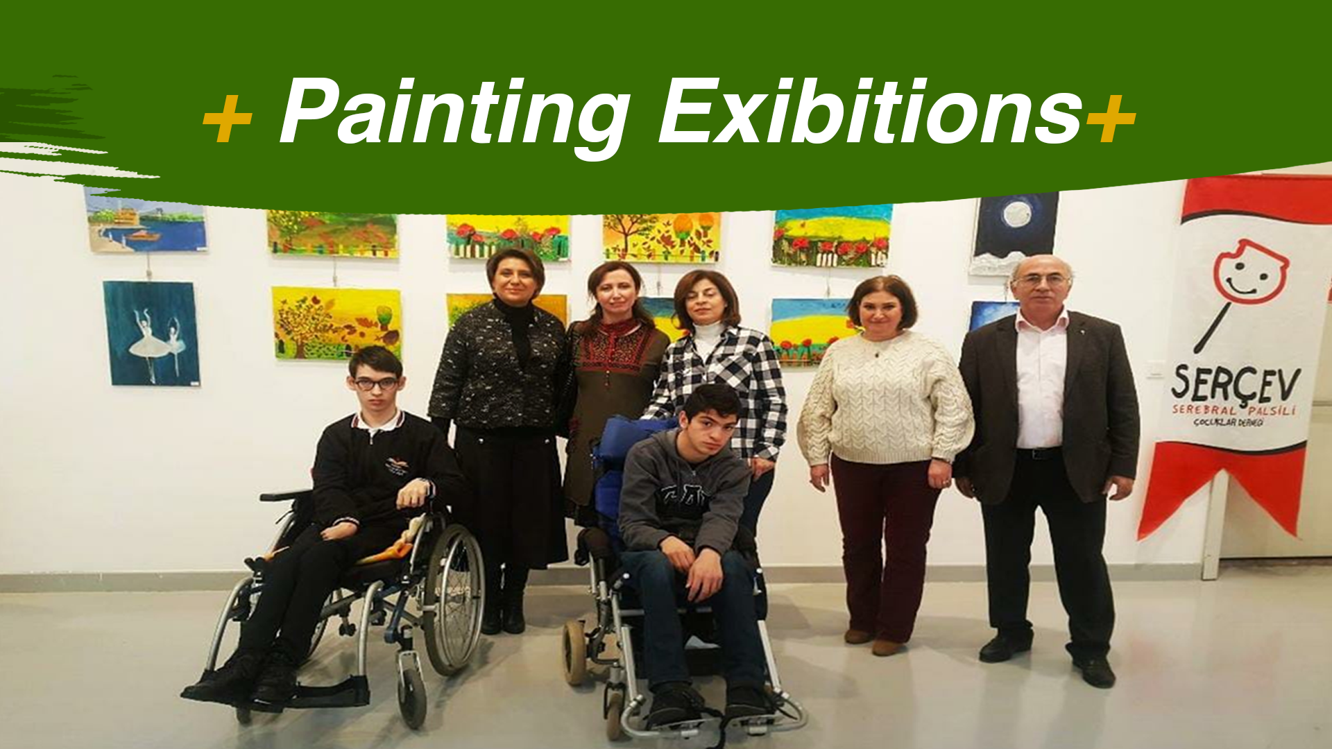
Notes:
Each year on the December third,
the International Day of Persons with Disabilities
our special education students have a painting exhibition in the Capital City`s Contemporary Art Center.

Slide 25
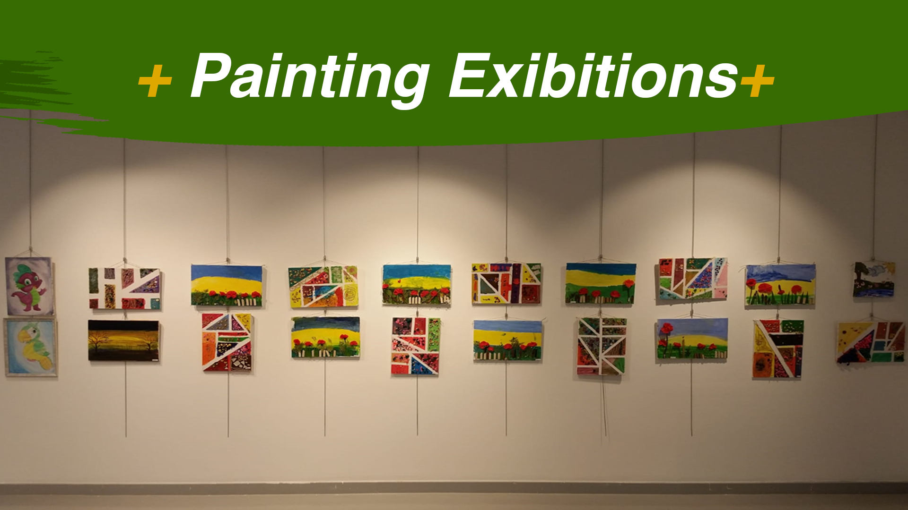
Notes:
Here is an example.

Slide 26
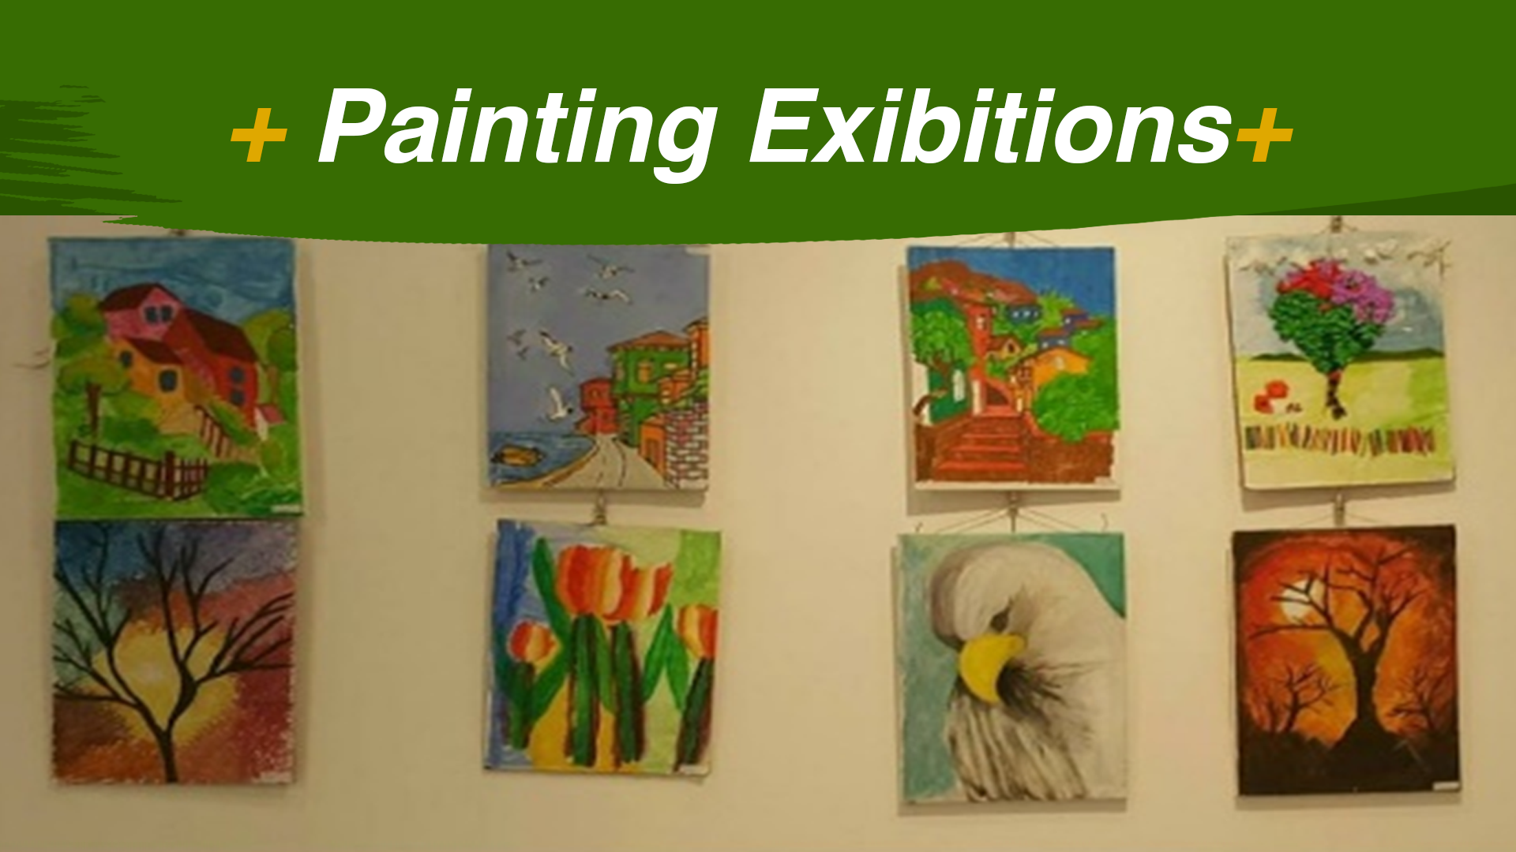
Notes:
Our school also serves (sörvs)
to anyone
who wants to take education in fields like
painting,
marbling
and handcraft course center.

Slide 27
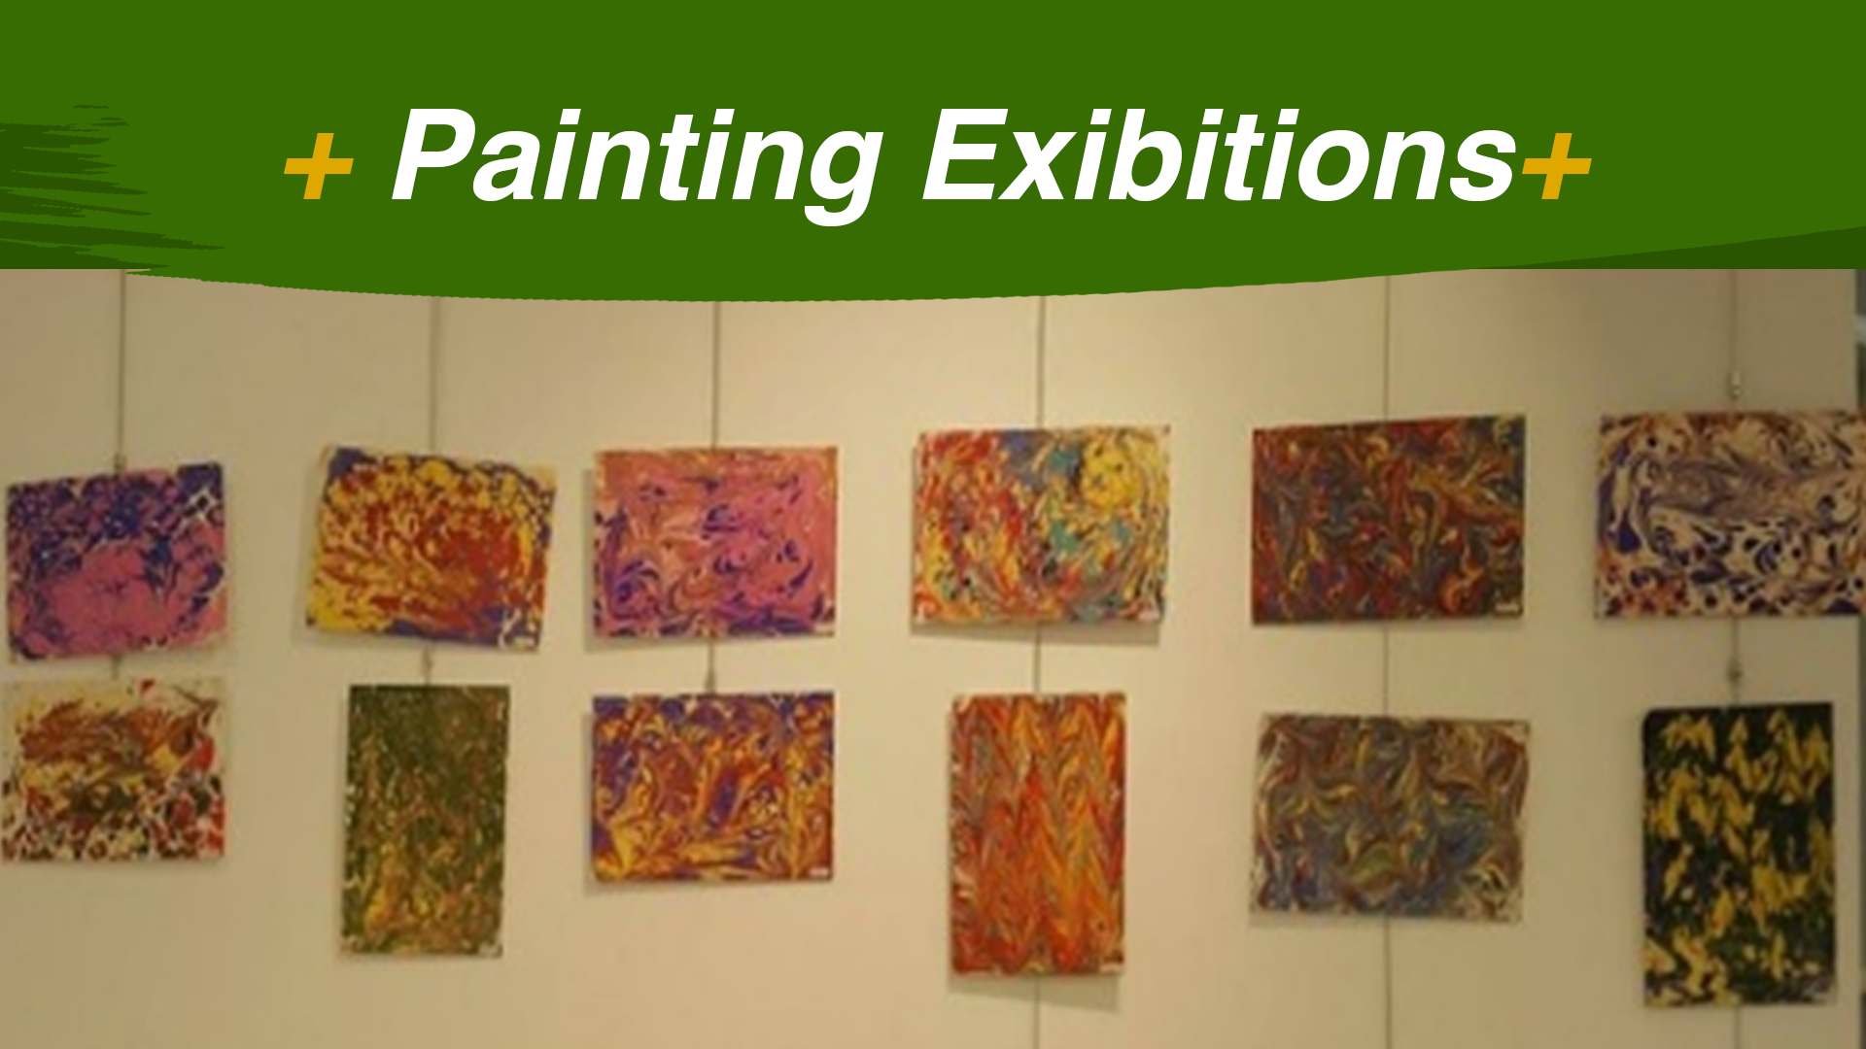
Notes:
The marbling technic
uses the mobility of the water (votır)
and the suspended colors
to create
free form shapes
or combed patterns.

Slide 28
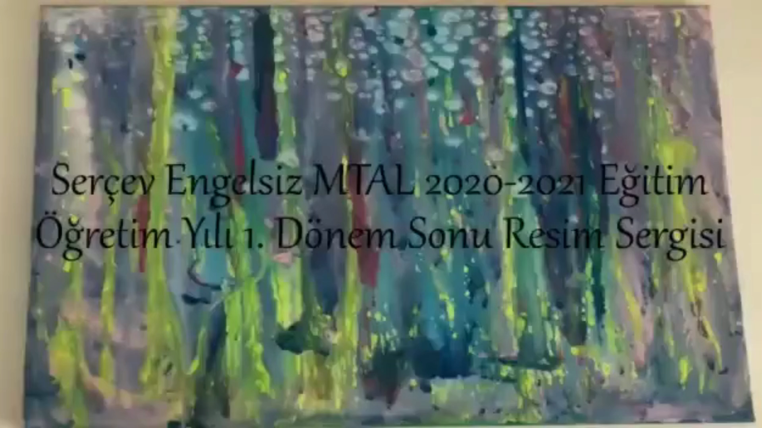
Notes:
Every year
we have a painting exhibition
at the end of the semester.
Last year,
It was an online exhibitation
due to Covid.,
Let`s watch it.

Slide 29



Notes:
We hope
this general descriptation
shows
how unique
and special is our school.
Thank YOU for listening
We can move on
to the next presentation.

